Slide 1
Nepali News Classification Using Naive Bayes
Raju Shrestha
Roll No. 48/2079
29 May 2024

Slide 2

INTRODUCTION
The process of classifying the news articles according to its content is News classification.
Classification is a challenging task as it requires prepossessing steps to convert unstructured data to structured format.
Naive Bayes is a supervised machine learning algorithm.
It is based on Bayes theorem and works by calculating the probability of a data point belonging to that particular class.
Bayes theorem is given as;
Here, A, B are events: P(A|B) is the probability of A given B, while P(B|A) is the probability of B given A. P(A) is the independent probability of A, while P(B) is the independent probability of B.

Slide 3
PROBLEM STATEMENT
Labeling the news articles class manually becomes tedious and takes more time when a large amount of news comes together from different sources.
With increase in the number of news articles it is difficult for users to access news of his interest so, it is necessity to categorize news articles into different groups so that it could be easily accessed.

Slide 4
OBJECTIVES
The main objectives of this seminar report is to classify the Nepali news articles into different category using Naïve Bayes algorithm.

Slide 5
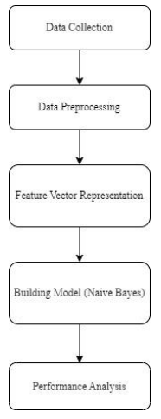
METHODOLOGY
For Nepali news classification supervised machine learning algorithm i.e. Naïve Bayes algorithm is used.

Slide 6
METHODOLOGY…
Data Collection:
Dataset used for Nepali News Classification is Nepali News dataset 20 categories which was collected from the publically available source i.e. from kaggle.com.
The dataset consists of news articles collected from various online news portal such as setopati.com, onlinekhabar.com, ekantipur.com etc.
The dataset consists of 4964 news articles among them 80% is used for training and 20% for testing the model.

Slide 7
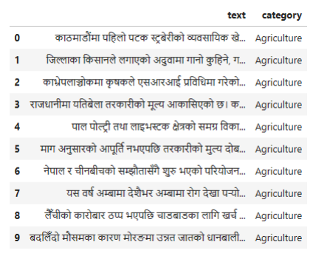
METHODOLOGY…
Nepali News Dataset Sample

Slide 8
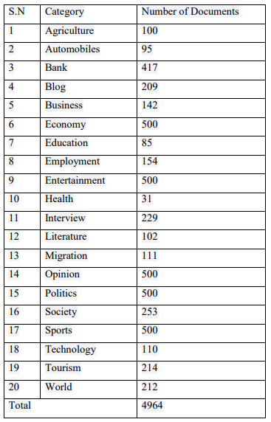
METHODOLOGY…
The News dataset consists of category of news article and the number of news articles per category.
The distribution of news articles in different categories are as follows:

Slide 9
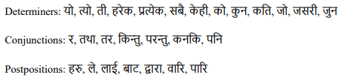
METHODOLOGY…
Data Preprocessing:
The news data consist of different properties in which most of it is not useful for classification.
Data preprocessing includes various step:
Stop words removal: Stop words are words which occur frequently and that may or may not have any meaningful uses for information retrieval process.
These are the common words which includes language specific determiners, conjunctions, and postpositions.
These stop words need to be remove before the processing of data.

Slide 10

METHODOLOGY…
Special symbol and number removal: Special symbols and numbers do not have much importance in classification hence they are removed.
The punctuation in the text consists of different types of symbols and numbers.

Slide 11
METHODOLOGY…
Word Stemming: After the removal of stop words the next activity that is to performed is stemming.
Stemming is used to reduce the given word into its root word.
Text preprocessing cleans the text data and make it ready to use in training and testing for the machine learning model.

Slide 12
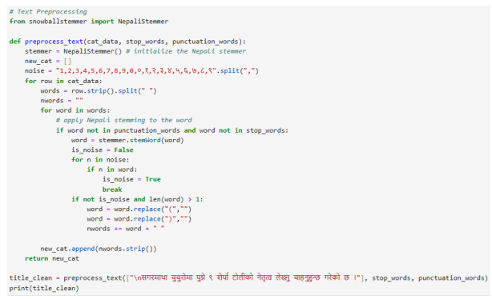
METHODOLOGY…
Text Preprocessing

Slide 13
METHODOLOGY…
Feature Vector Representation: It converts text into numerical representation.
For feature vector representation TFIDF technique is used.
It is a statistical method to find importance of word in a document.
Due to complex word segmentation of Nepali language, TF-IDF is one of the mostly used, easy methods to extracts features from text.
It mainly consists of two parts:
. Term Frequency (TF)
. Inverse Document Frequency (IDF)

Slide 14

METHODOLOGY…
Term Frequency (TF): It represents the occurrence of terms in a document.
In TF, scoring is given to words based on the frequency.
The frequency of words is dependent on the length of the document i.e. in large size document, word occurs more as compared to small size documents.

Slide 15

METHODOLOGY…
Inverse Document Frequency (IDF): It is the number of documents that contain a term in the collection of document.
The scoring is given to a word based on how a word is rare across all documents.
The IDF of a rare term is high, as compared to the IDF of a frequent term.
Formula to calculate complete TF-IDF value is;

Slide 16
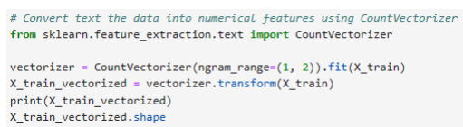
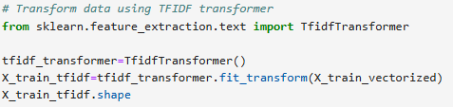
METHODOLOGY…
Feature Vector Representation

Slide 17
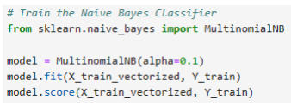
METHODOLOGY…
Model Training:
For training model multinomial naïve bayes is used. It is commonly used in NLP for document classification tasks.
Multinomial NB is computationally efficient and can handle large datasets with many features.
Model Training using Multinomial Naïve Bayes

Slide 18
IMPLEMENTATION & TESTING
The algorithm is implemented using Python programming language and Jupyter notebook as software environment.
The various libraries used are:
Pandas: Used for data analysis and manipulation.
Numpy: Used for working with arrays and matrices.
Matplotlib: Used for 2D visualization.
Sci-kit learn: Simple and efficient tools for predictive data analysis.
NLTK: It can be used to perform various NLP task such as tokenization, stop words removal & stemming.

Slide 19
IMPLEMENTATION & TESTING
Among the total dataset used 80% of the data is used for training and 20% is used for testing purpose.

Slide 20
CONCLUSION
Nepali News Classification Using Naïve Bayes algorithm is successfully implemented in Python programming language.
It classifies the news articles by analyzing the content of the news.
The accuracy of the model on test data set is 82.20 %.

Slide 21
REFERENCES
[1] J. Sreedevi, M. Rama Bai and C. Reddy, "Newspaper Article Classification using Machine Learning Techniques," International Journal of Innovative Technology and Exploring Engineering, vol. 9, no. 5, March 2020.
[2] S. D. Mahajan and D. D. Ingle, "News Classification Using Machine Learning," International Journal of Innovative Science and Research Technology, vol. 6, no. 5, May – 2021.
[3] M. Sundarababu, M. Ch.Chandra, M. Suthar, C. Harsha, L. Juveria and B. Blessy, "NEWS CLASSIFICATION USING MACHINE LEARNING," JETIR, vol. 7, no. 3, 2020.
[4] S. S. Wagle and . S. Thapa, "Comparative Analysis of Nepali News Classification using LSTM, Bi-LSTM and Transformer Model," Proceedings of 10th IOE Graduate Conference, vol. 10, October 2021.
[5] S. Subba, N. Paudel and T. B. Shahi, "NEPALI TEXT DOCUMENT CLASSIFICATION USING DEEP NEURAL NETWORK," Tribhuvan University Journal TRIBHUVAN, vol. 33, June 2019.

Slide 22
REFERENCES…
[6] S. K. Thapa and S. Pokhrel, "Nepali News Document Classification using Global Vectors and Long Short Term Memory," Proceedings of 9th IOE Graduate Conference, vol. 9, March 2021.
[7] T. B. Shahi and A. K. Pant, "Nepali News Classification using Naïve Bayes, Support Vector Machines and Neural Networks," International Conference on Communication, Information & Computing Technology (ICCICT), feb 2018.
[8] O. M. Singh, "Nepali Multi-Class Text Classification," Department of CSEE University of Maryland, Baltimore County, December 20 2018.
[9] K. Acharya and S. Shakya, "An Analysis of Classification Algorithms for Nepali News," International Journal of Innovative Science, Engineering & Technology, vol. 7, no. 7, July 2020.

Slide 23
Thank You

